Slide 1

The Multigenerational Library Workplace
Carla Arbagey, Millennial
STEM Collection Strategist Librarian
University of California, Riverside
Notes:
Introduction – first became interested in this topic when I was made head of our acquisitions unit, and everyone I supervised was older than me – even one person who had originally interviewed me as a student assistant! They also represented three different generations, so I was curious about how that could influence their working style and how I could best support them as their new manager.

Slide 2
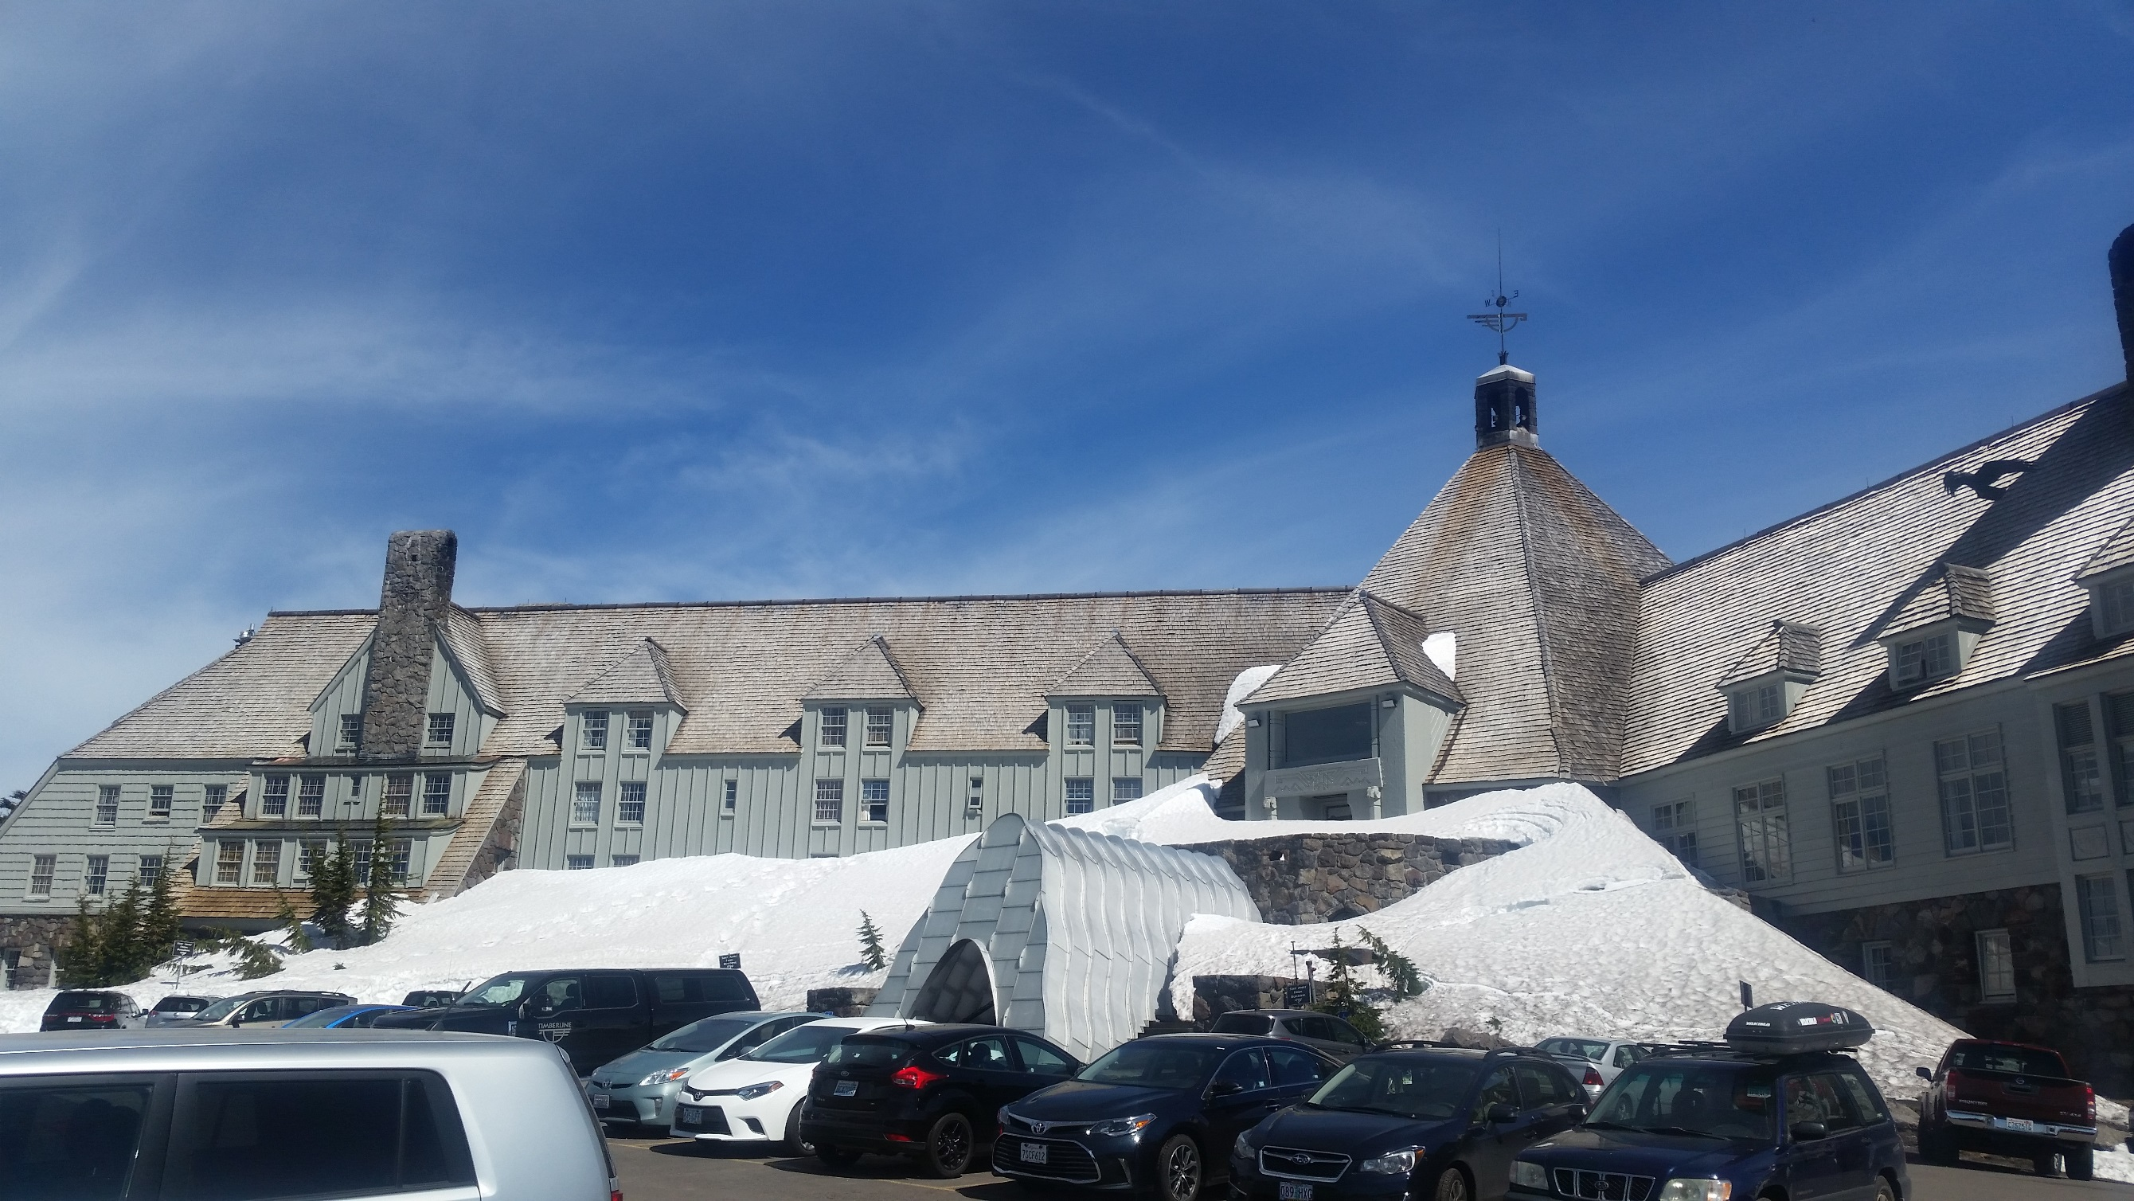
Acquisitions Institute, May 20-23, 2017
Timberline Lodge, Mt. Hood, Oregon
Notes:
I gave this presentation at the Acquisitions Institute, an annual conference held at the historic Timberline Lodge. The AI is an intimate, single-track conference for those involved in acquisitions, collection development, electronic resource management, even publishing/library service & vendors. I have attended the institute for the past 3 years, and diversity in collections and acquisitions has been a hot topic. This year it was a bit more of a focus; the keynote speaker, DeEtta Jones, talked about how library leaders can engage and unleash the potential of the library workforce, especially through diversity, inclusion, and cultural competence. I had the pleasure of following the keynote, and my topic fit in well with some of the themes that DeEtta talked about.

Slide 3
Warning!
On age diversity vs. generational diversity:
Characteristics that reflect stage of life vs. generation
On generalizations:
Think in terms of generational trends, not stereotypes
Notes:
-It can be easy to get confused between age diversity and generational diversity, although there is some intersection. We are talking about generations, not stage of life.
-In the literature there is a good deal of debate about whether classifying workers in terms of the generation is useful, or whether it is veiled stereotyping. It’s true there’s a thin line here – you may have heard stereotypes that all Millennials are entitled narcissists, or that Baby Boomers are stubborn and unwilling to change. On the flipside, research shows that there are differences between the generations, which can be helpful for us to use in understanding our workplace and relationships with coworkers.
Thinking back to my own experience as a supervisor, I was lucky enough that our campus employee development office offered a workshop in multigenerational diversity. After that workshop, I found that a generational lens helped me better understand my coworkers, like a lightbulb going on – Ohhh, that’s why they do that!
-Remember that one’s generation is not the whole picture; other factors may influence who we are in the workplace, such as gender, race, socioeconomic status, and more. I will focus on the defining influences of each generation which can impact the workplace, but keep in mind that these are not the only influences. So, understanding generational characteristics can help us better empathize with our coworkers and patrons.

Slide 4
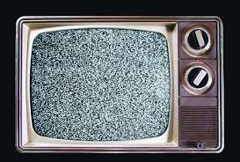
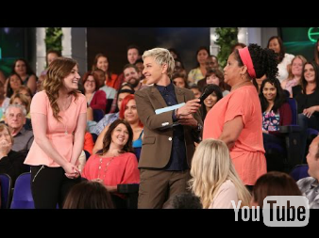
What is a generation?
Notes:
So, what is generation anyway? Let’s take a look at this short clip from the Ellen Show. Watch the video from Ellen https://youtu.be/JADG4hXaqy4 (4:30). This is all very funny and entertaining, but note how Ellen and her two audience members talk about the things that define our generations: health outlook (drinking out of the hose vs. purified water), Marriage, family and sex (making whoppee vs. Netflix & Chill, dating app/hookup culture in Tinder), Technology (rotary phone!), Music, television, and even the way we communicate – YOLO and text message lingo.

Slide 5
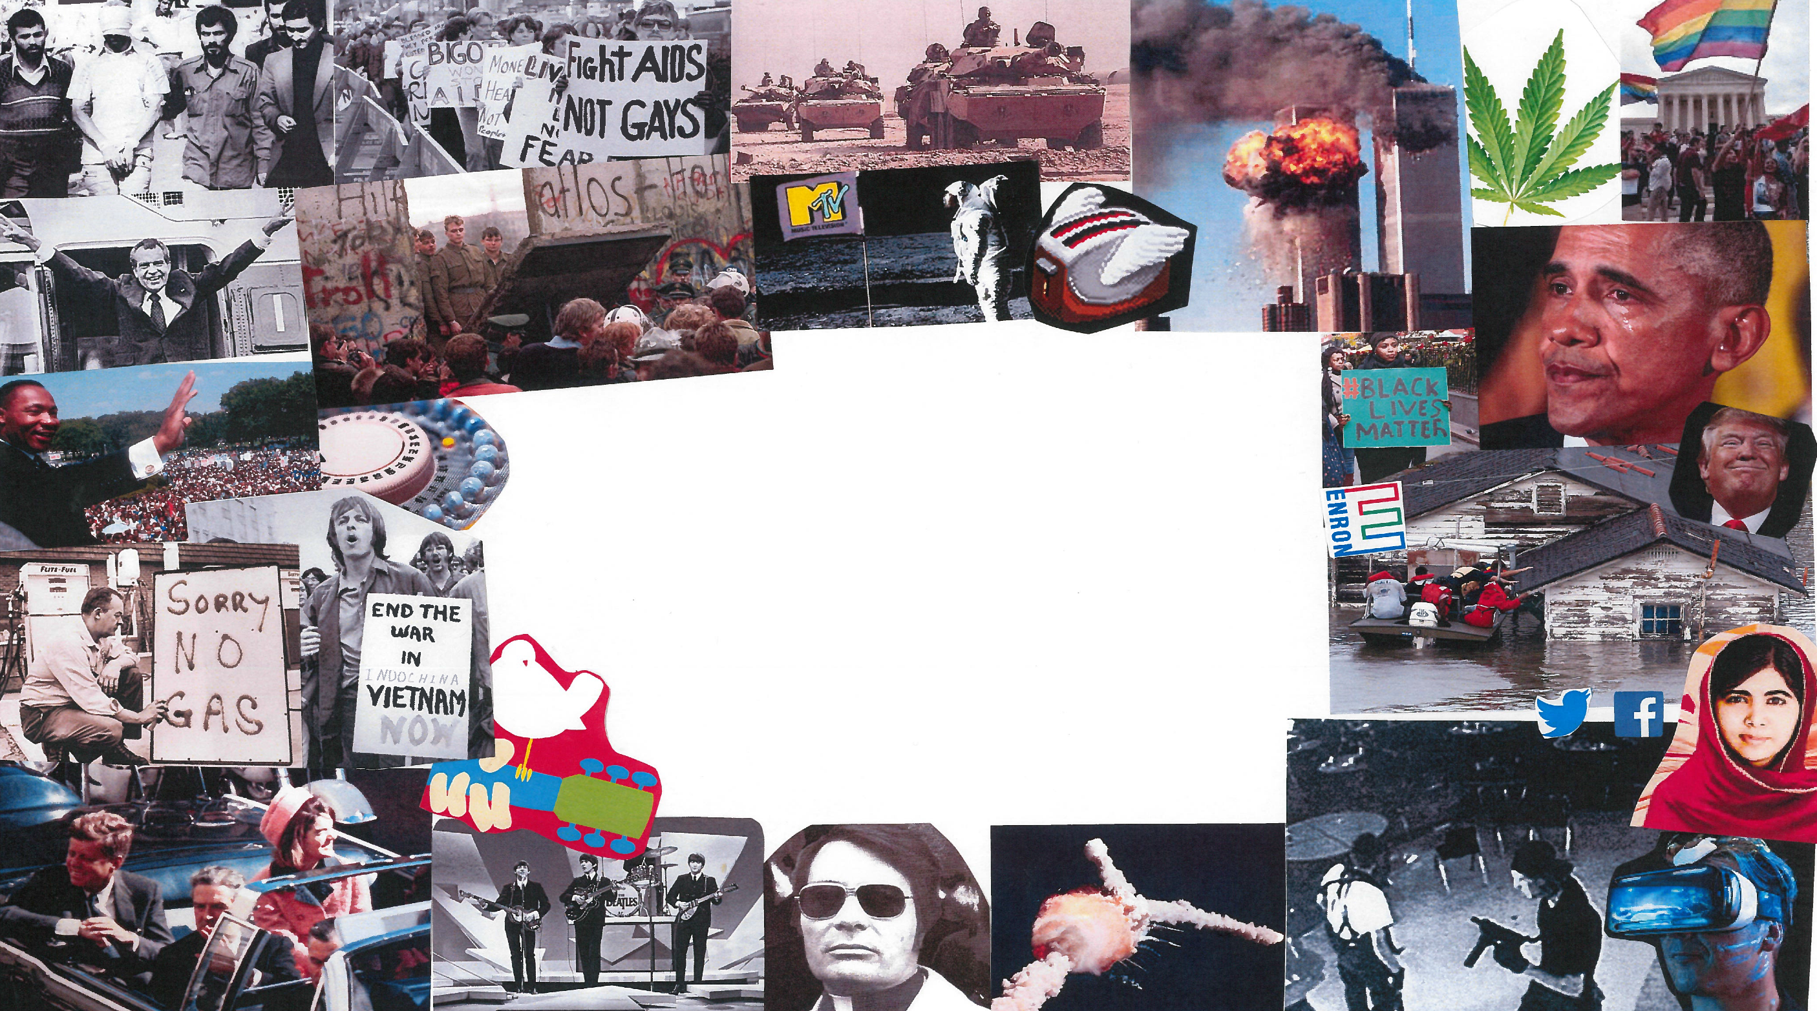
A generation is…
A group of people born within a specific date range, having a worldview
formed from shared experiences of defining events and trends.
Notes:
So, as you are looking at these images, you might be having an emotional reaction, or a flood of memories – think about how these events and trends have influenced you, and how they might have influenced your coworkers.
Generational theory has a deep history. As a lens for looking at United States history and culture, it was popularized with the book Generations: The History of America’s Future, published in 1991 and written by William Strauss and Neil Howe. It was this work that explored how a particular age group tends to share a distinct set of beliefs, attitudes, values and behaviors influenced by events and trends experienced during their formative years.

Slide 6
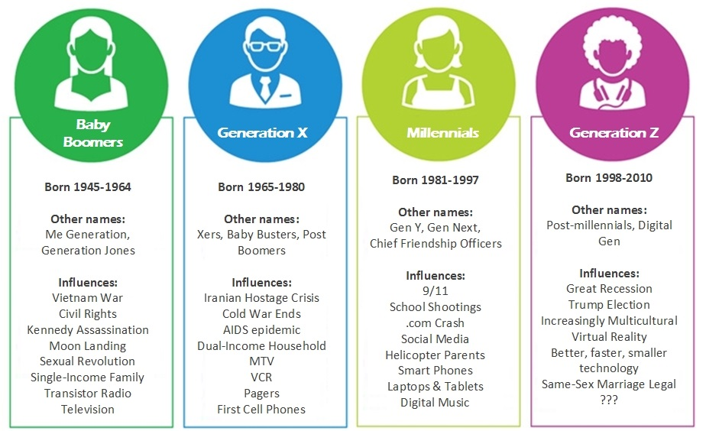
Notes:
-Here are the major generations that we encounter in the workplace. The majority of our workforce consists of just three gens: Boomers, Gen X, and Millennials, however it’s possible that you could have members of the silent gen still working with you, and you might have Gen Z among your student workers, volunteers, and new hires. However for the sake of time I will focus on the three gens that are most populous in our workforce, with some attention to Gen Z as well (in many ways with this gen the jury is still out and there is less data available about their work style). Most of the literature, even as recent as 2013, still cites the Silent Gen as being part of the workforce and includes no mention of Gen Z, so there is precious little research out there about what Gen Z will be like when they become librarians. Plus, this gen is still in its formative years, so there are likely influences that we cannot predict their impact or that haven’t happened yet. For example, back in 2000, one article talked about Pogs and Tamagotchi digital pets as being big Millennial influences!
-Let’s take a look at some of the major influences in each generation. (Read off a few) Common themes include disasters and “bad” things that happened, but also major technological advances and cultural shifts.
-Keep in mind that these are how generations are thought of in the US, other countries have different generational cohorts. If you happen to do any reading into this topic, you’ll find that the dates vary: some say Millennials begin in 1982, others 1980. Generations aren’t exact, and there’s wiggle room, so I have used the dates I found used most frequently in my sources.

Slide 7
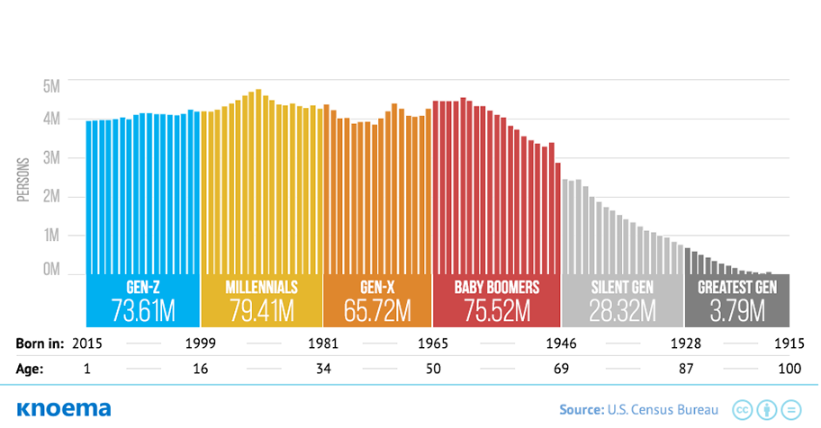
Generational Makeup of the US
As of December 2015
Notes:
Let’s take a look at the generations as they are in the United States. Here’s a snapshot from 2015, but now that we are in 2017, you can imagine that our older generations are decreasing, while a new generation is forming after Gen Z (not pictured here, but some are calling it Generation Alpha, born as early as 2011)

Slide 8
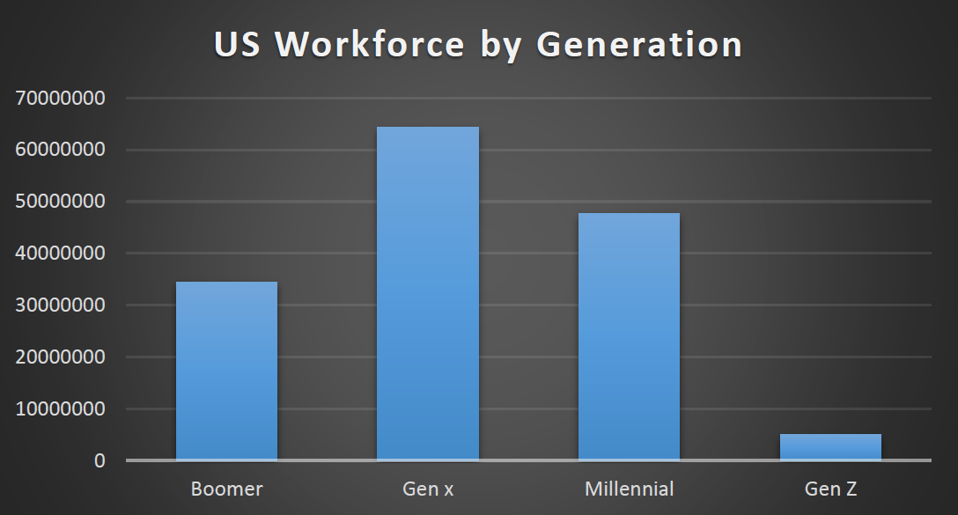
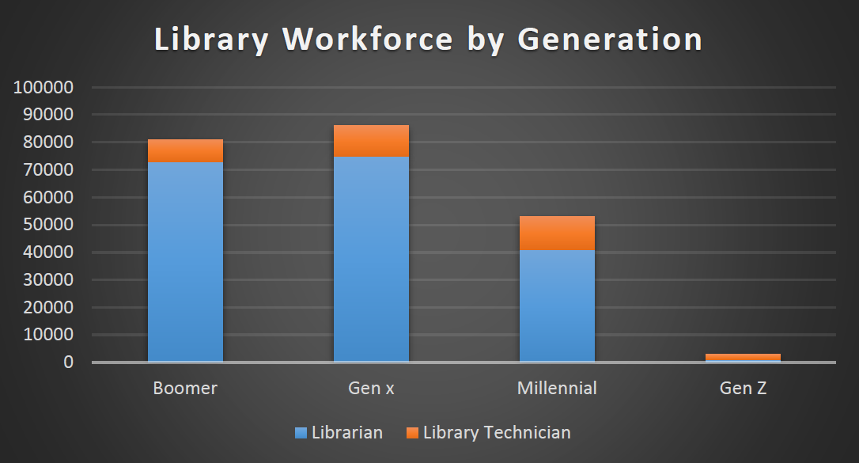
Generational Makeup of Library Workers
Source: Labor Force Statistics from the Current Population Survey, Bureau of Labor Statistics, https://www.bls.gov/cps/cpsaat11b.htm
Notes:
Let’s take a look at the generations in libraries, from the Bureau of Labor Statistics. Compared to the entire workforce, there is a greater proportion of Boomers working in libraries. There are fewer Millennials and Gen Z library workers compared to the entire workforce. This data is supported by statistics from the Association of Research Library surveys: 2010 data showed that 66% of library directors are older than 60, and that 1 in 4 catalogers are over 60. Alarmingly, ARL projected that between 2010 and 2020, our workforce would have more of a bell curve in age ranges and more closely match the graph you see on the left, however the data here (on the right) is from the 2016 Current Population Survey. I think this matches what we can observe in our libraries, where you may have those closer to retirement deciding to continue to work for a few more years, or who seek bridge employment after retirement. What it boils down to is that we have an older workforce in our libraries, and the likelihood of more and more librarians retiring in the next few years, an issue that we’ll talk about in a detail later.

Slide 9
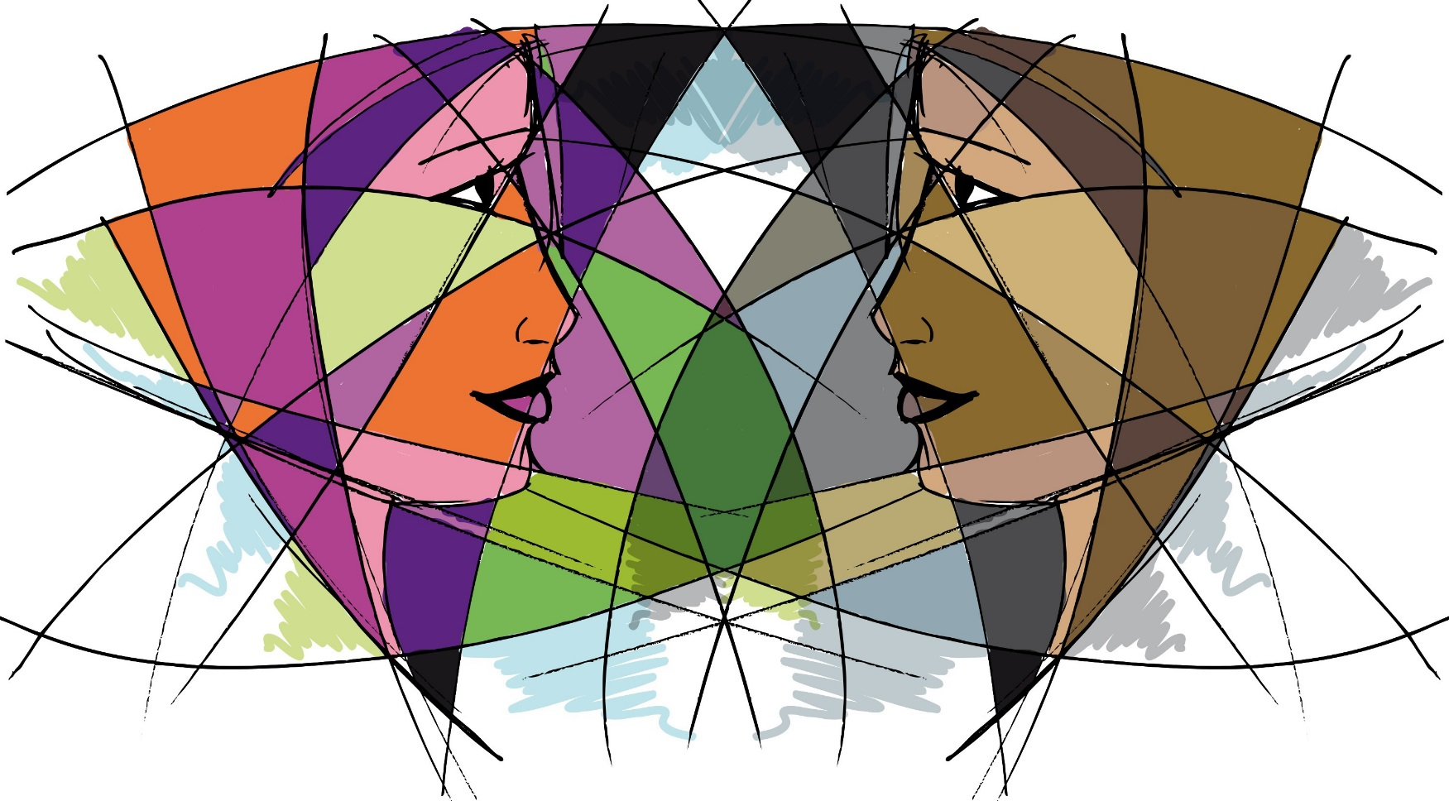
What’s our library like?
Notes:
Depending on your department or division, and likely a host of other factors, you probably have a mix of generations that you work with. I would say we have a good mix of generations in the library as a whole, with younger generations increasing. However, we have one really big group of a certain generation that we work with…can you guess? Gen Z! That’s right, most undergrads are Gen Z. So, what’s your department like? Raise hands: Who has a lot of Boomers in their department/library? Who is seeing more Millennials and Gen Z? Who has a balanced workforce?
Let’s explore the characteristics of each generation in the workplace.

Slide 10
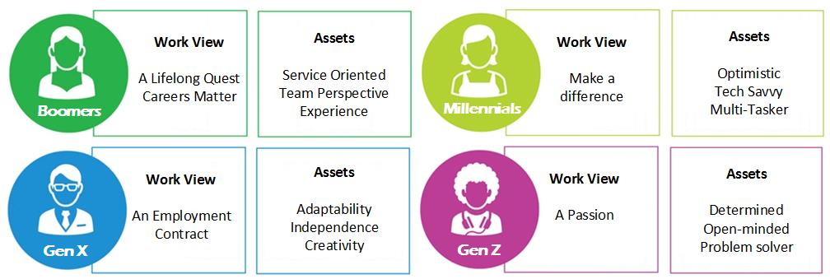
The Generations at Work
Notes:
Here’s a very brief look at each generation in the workplace. Boomers look at work as a lifelong adventure, and strive to grow their careers by climbing the corporate ladder. They have often been in the workforce for some time, and so have a lot of experience and institutional knowledge. Gen Xers see their work more as a means to and end. You’ll often hear that Gen X had more latch key kids, which translates into working well independently. Millennials will seek work where they can make a difference in the world, and having grown up in the 90s and 2000s, they can be more tech savvy and do well with multi-tasking.
Gen Z, seeing that even good, smart, and hard-working people could lose their jobs in the recession, may feel lucky just to have a job, and determined to work hard to keep it. They can be a bit like Millennials in that they desire work thye are passionate about, whether it is a cause or their own invention.

Slide 11
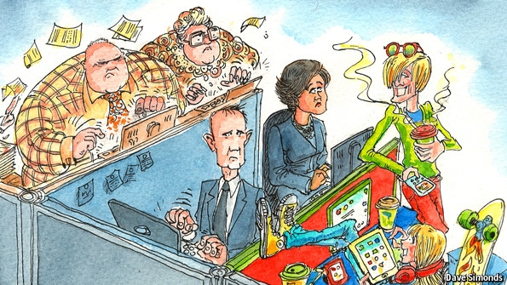
The Big Divides
Preferred Leadership Style
Time at Work
Teamwork/Collaboration
Technology and Communication
Rewards and Recognition
Notes:
As you can see, members of each generation may have a different approach to work, which can lead to some pain points in the workplace.

Slide 12
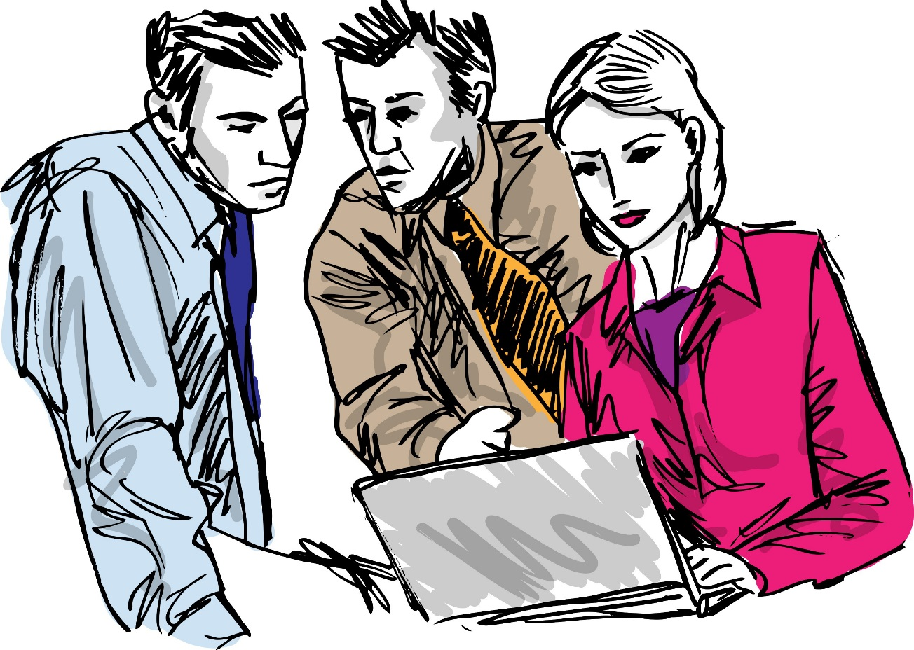
Preferred Leadership Style
Boomers: Chain and Change of Command
Gen X: Self-Command
Millennials: Don’t Command, Collaborate!
Gen Z: Comrades and Commanders
Notes:
Boomers have a respect for authority and the chain of command now that they are later in their careers, however earlier they were interested in the change of command, or participating in workplace decisions. Gen X is more independent and appreciates minimal management. Millennials, remember one of their names is Chief Friendship Officers, are interested in collaborating and having equal participation on work teams. They may prefer flat organizational structures, and therefore want to get more involved in making big decisions. Gen Z may feel lucky to even have a job, and so may work well with many leadership styles, however they also want to create their own income opportunities and be their own boss/commander.

Slide 13
Time at Work and Work Philosophy
Boomers: Work/Life Imbalance: Live to Work
Generation X: Work/Life Balance: Work to Live
Millennials: Work/Life Blended: Work is Fun
Gen Z: Work for a Purpose: Work is a Passion
Notes:
The hard-working boomers might feel that taking too much time off work meant they could lose their status, so they tend to place a greater emphasis on showing up and sticking to the 40+ hour work-week, they live to work and figure that they will balance this commitment with retirement. Gen X, as children of the boomers, want more balance between their work and personal time. Millennials see work as more blended: the lines between work and personal time are blurry, so you might find them rattling off e-mails at 10 at night or checking their social media during work. They also want work to be fun, which may translate to a more casual attitude at work than Boomers and Xers are used to. Gen Z are hard-working and determined, and a bit like the Millennials, Gen Z wants their work to have a purpose and to change the world, so we may see them integrating their work with personal passions (social justice and libraries, for example)

Slide 14
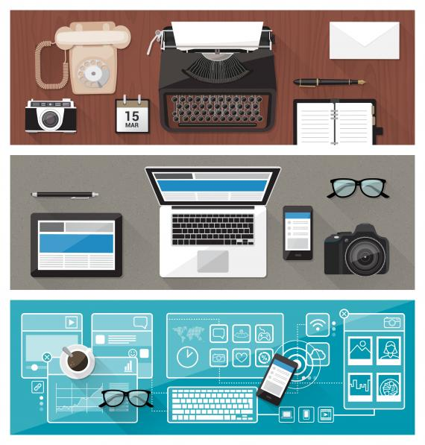
Technology
Boomers: Adapted, technology as a tool
Gen X: Integrated new technology
Millennials: Technology is air
Gen Z: Interactive technology, technology-focused careers
Notes:
All generations have seen amazing changes and advances in technology, and all have had to adapt and incorporate it into their work: the Boomers perhaps more so, whereas as digital native Millennials and Gen Z see technology as integral to nearly all aspects of life. In addition to the changes in technology that everyone has experienced – computers, phones, and so on – library workers also have to constantly adapt to new library technologies, from card catalogs to ILS and discovery services, jammed copiers and old microfilm readers. I think library workers are more tech savvy, no matter their generation, compared to other workforces. Even so, we can see differences between the generations in their approach to technology, whereas Millennials may be quick to adopt the latest and greatest tech trend, others may be more cautious. Communication technology can also vary between the generations, whereas Boomers may prefer face to face interaction, Millennials may prefer e-mail or even text messages!

Slide 15
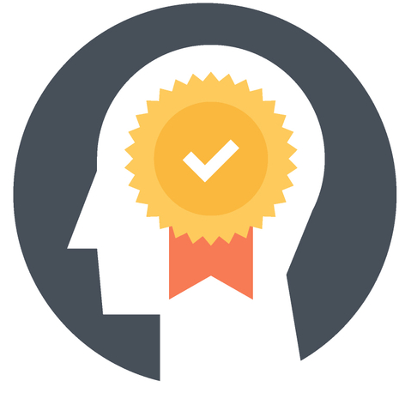
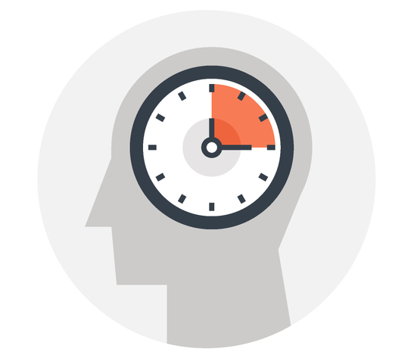
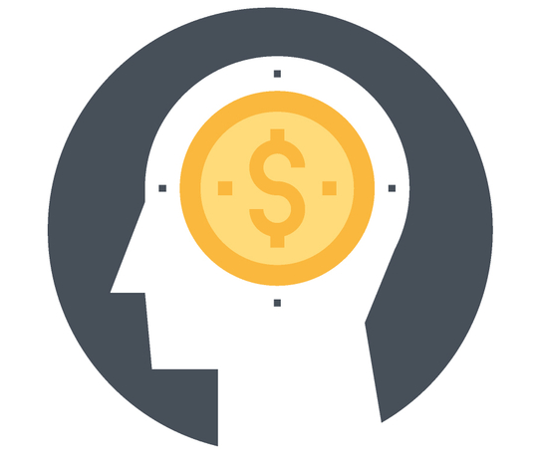
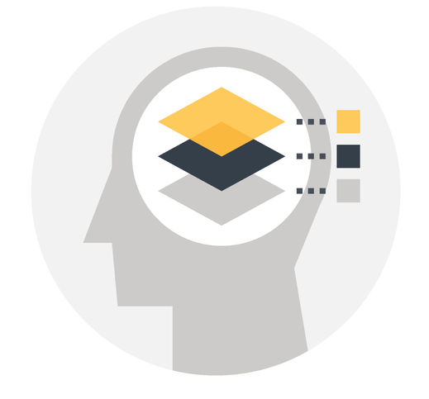
Rewards and Recognition
Boomers: Appreciation, valued work, promotion
Gen X: Results-driven, free time
Millennials: Praise and feedback, pay raise
Gen Z: Problem-solving, participatory leadership
Notes:
Boomers like to know that their work and loyalty is valued and appreciated, they strive for promotions. Gen X values their free time as a reward, but they enjoy achieving measurable results, so may be motivated y a results-driven workplace. Millennials desire praise for work done, which can sometimes conflict with other generations who think you don’t need recognition for doing your job. They can be driven by financial incentives (although we all appreciate a pay raise, the outlook for Millennials is a bit different – student debt, inflation=not as easy as it was for their parents) , whereas younger Gen Z, who has seen rising unemployment rates and the recession can be thankful to have a job. They want intrinsic rewards, want to feel like they can solve a problem and help save the world.

Slide 16

What do you think the generations can learn from one another?
What do you think are potential points of conflict or misunderstanding?
Notes:
Have a conversation about how these big divides can lead to conflict. Ask questions for audience participation. Possible answers: learn new tech from Millennials, Boomers may see using phones/social media at work as lazy; Micromanagers might clash with independent Gen X; Gen X and Millennials may switch jobs/institutions frequently while Boomers remain loyal; Millennials prefer digital communication over F2F, Millennials and Gen Z have no problem with blending work and free time, may be checking phone or social media while at work but Boomers see this is a problem/slackers; Generally each generation thinks it is the best and can find faults in other gens.

Slide 17

How to Maximize Your
Multi-Generational Workplace
Check: What is the generational makeup of your workplace?
Assess: Is your workplace cross-generationally friendly?
Notes:
Find out the generational makeup of your workplace, either by looking at data or through conversations with your colleagues (that is, don’t ask them their age but perhaps which generation they identify with).
Asses if your workplace is friendly for all generations: I have included an assessment taken from an excellent book called Generations at Work (which we have as an ebook!). [note that I found a mistake in the scoring of Question 7, so I hand-wrote the correct scores]

Slide 18
Succession Planning
Notes:
One of the biggest things that we can do to maximize the benefits of having a multigenerational workforce is to think about succession planning. Recall the graph I showed earlier, which shows the makeup of the US Library workforce.

Slide 19
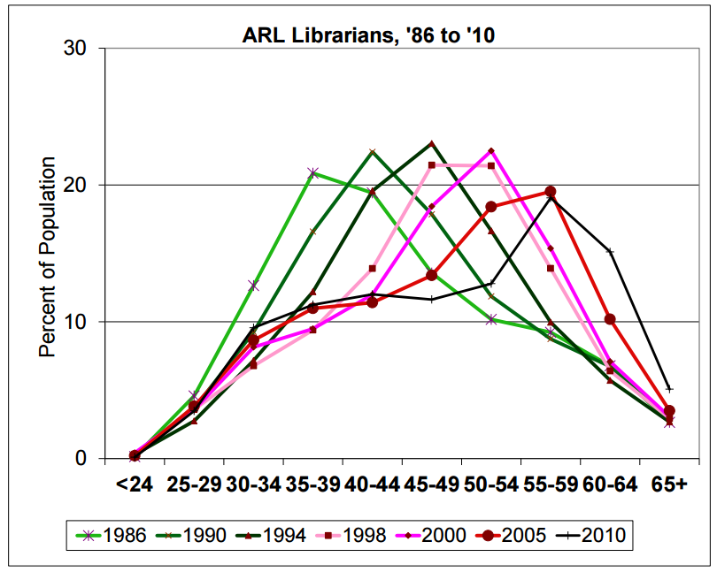
Generational Makeup of ARL Libraries
https://www.arlstatistics.org/documents/LibQual/publications/2013/analyzing-age-race-ethnicity-demographics-nov-5.pdf
Notes:
Let’s take a look at that data a bit more closely, and focus in more on academic libraries. Here’s a graph from ARL (Association of Research Libraries, a group of the top 150 research libraries in the US, of which UCR is a member). It’s from a presentation by ARL from Nov. 5 2013. Take a minute or two to really let this sink in.
In this graph you can see how we’ve had a large cohort of librarians from the Boomer generation. They entered the profession in the 1980s, and stayed. And stayed. And not that many new librarians entered the profession. If we had an equal number of librarians starting and retiring, this curve would be stable.
By the way, Mark Puente, director of diversity and leadership programs at ARL, was a part of this presentation – he’ll be here in the library in two weeks for our Committee on Equity Diversity and Conclusion kickoff event. Definitely check out this webinar, it’s listed in the references handout.

Slide 20
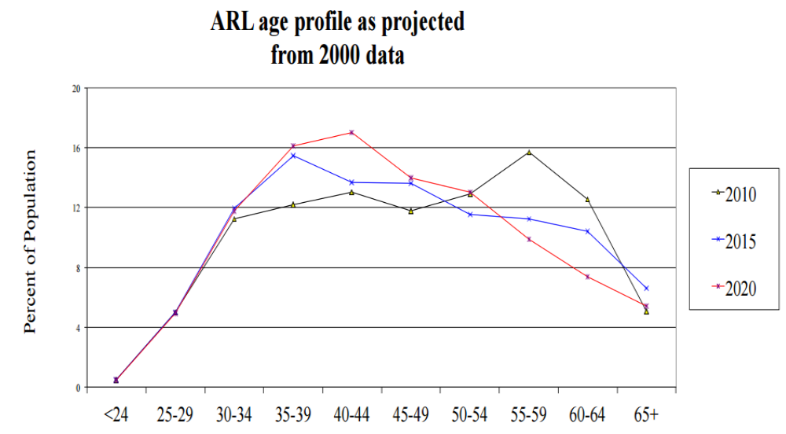
Where the Generations are Headed
Notes:
So let’s take a look at where we might end up. Here’s a graph from the same presentation that predicts where our workforce is going. Interestingly, ARL’s prediction for 2015 didn’t quite come true – as we saw in the previous graph, which has data from Jan. 2016, Boomers still make up a large portion of the library workforce. And perhaps that is lucky for us, because what this data shows is that we really need to focus on our succession planning: how do we transfer the wisdom and expertise of these librarians to the younger generation? This is one of the big keys to maximizing the benefits of our workforce – take advantage of the experience of the Boomers while they are still working for us; we need to connect the generations through mentoring programs and forming diverse teams and working groups.

Slide 21
More Ideas
Training on (Multigenerational) Diversity
Recognize bias and avoid microaggressions
Management Practices: Equality, Support, Options
Reciprocal Mentoring / Buddy Programs
Build multi-generational teams
Mix it up, get together, have fun!
Notes:
-First and foremost, diversity training and awareness for employees, which includes generational theory. I think we are really good at looking at diversity in terms of gender or race, but there are other aspects of diversity that can help us refine our understanding of the diverse workplace.
-Be aware of your won bias towards a generation or age group. It’s also easy to commit microaggressions when it comes to generation, we’re always hearing some bad stereotype about Millennials or Gen Z, which can be easy to repeat. Remember that this is still a microaggression, or even ageism.
-Ensure that your management practice, at all levels, avoids age and generational discrimination. Make sure they support the generations with options such as flexible work arrangements and on-the-job training
-Reciprocal mentoring: not just learning from mentors to mentees, but also Boomers and Gen Xers learning from Millennials and Gen Z. This could be in the form of a buddy program, something I am looking to setup this year as LAUC president with the LAUC Connect program.
-Build multi-gen teams to take advantage of diverse skills and viewpoints, and to make all gens feel included
-Mix it up: increased interactions among gens will help break down stereotypes and get to know individuals – this is great when done outside of “work” such as dept. lunches, outdoor meetings, celebrations. I saw a great example of this in the recent Library Professional Development Committee workshop, when we randomly formed groups of 5 and tried to come up with 10 things everyone has in common. Be sure to take advantage of workplace programs, too. For example, our Wellness Program events can bring together diverse teams for fun outside of the office. The more we get together and communicate in casual, or at least non-threatening situations, the better we understand one another.

Slide 22
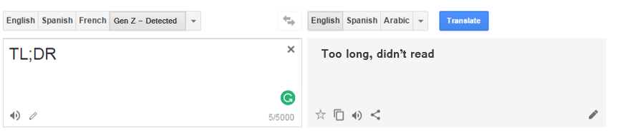

Sources and Further Reading
See handout or e-mail carlar@ucr.edu
TL;DR: see AARP’s “Leading a Multigenerational Workforce”
https://bit.do/multigenAARP

Slide 23
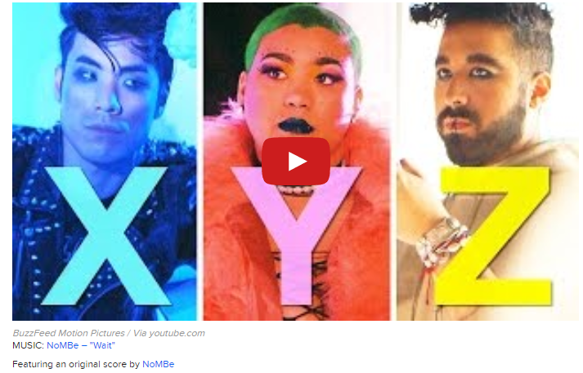
Just for fun…
BuzzFeed Video and Quiz: http://bit.do/BuzzGenVideo
Notes:
https://www.youtube.com/watch?v=IfYjGxI6AJ8

